Slide 1
Glendale Quiet Zone
Village Council Public Hearing 06.19.17
Notes:
Thank you for giving me the opportunity to once again update you on our Quiet Zone progress.

Slide 2
Over the Past 13 Months
Efforts to quiet the train horns
Notes:
Glendale has been investigating a Quiet Zone since at least the year 2000.
But I want to talk about our current efforts, which began a little over a year ago.

Slide 3
First Steps Organizing Meeting
Initial Call for Volunteers
May 3, 2016
Eblast
Notes:
On May 3 last year, an email went out to all subscribers on the Village email list (about 800).
The email blast asked for volunteers to study the Quiet Zone issue once again. We asked those in favor of a Quiet Zone, those opposed to it and those undecided to join us in investigating the issue.
We received 51 responses to this email, and 23 people attended our first Quiet Zone meeting on May 10.

Slide 4
Organizing Meeting Progress Study Groups Formed
Health effects of horns
Financial implications of Quiet Zone
Possible crossing closure
Train frequency, noise levels
Property values
Residents’ views
Notes:
At that meeting we divided into study groups to explore what we felt were the key issues.
Health effects of horns
The financial implications of implementing a Quiet Zone in Glendale
Possible options for closing a crossing
The number of trains coming into the village now, and projections for the near future
Train horn decibel levels
The effect of train horns on property values
And the need for a questionnaire to get residents views on silencing the horns.
Ultimately, we came to the conclusion that the high cost was what stopped all previous attempts, and it would be our greatest hurdle.

Slide 5
Early Research: Contacts with State Officials
State Representative connected us to ORDC
Learned funding available for safety issues
ORDC conducted diagnostic assessment of Glendale crossings
Mayor received proposal in September
Notes:
In parallel with this work, I contacted our State and National representatives to explore funding options. Representative Bill Seitz’s office connected me with Matt Deitrich and the Ohio Rail Development Commission. Matt explained there was limited funding available, but only for matters of safety. The State then conducted a diagnostic assessment of the crossings in Glendale.
That review took place on July 19, 2016. It included representatives from the Ohio Department of Transportation, CSX and ORDC. The results indicated two significant safety concerns:
The pedestrian walkway from the municipal parking lot
And, according to Ohio Rail Development Commission, out of 5,700 crossings in Ohio, Albion is considered the 90th most hazardous.
On September 14 the Mayor received a formal proposal from ORDC.

Slide 6
Terms of the Proposal: Glendale’s Responsibilities
Relocate pedestrian crossing to Sharon Road
Install additional two gates and vehicle detection system at Oak Road
Convert N. Greenville Avenue to “no entrance”
Accept closing of Albion Road crossing
Share of project costs: $265,000
Notes:
The terms of the proposal required Glendale to close the existing pedestrian crossing.
To install two additional gates and vehicle detection system at the Oak Road crossing.
And because new gates at the Sharon Road crossing would reduce the clearance at North Greenville Avenue, we had to agree to make that roadway “ no entrance.”
Previous efforts to establish a Quiet Zone were estimated to cost the village as much as $1.3M. This time, our share of the project costs were estimated to be $265,000.
And for the first time this idea seemed possible.

Slide 7
Terms of the Proposal: ORDC and CSX Responsibilities
Install second set of gates, vehicle detection system at Sharon crossing, upgrade safety equipment
Upgrade Sharon and Oak crossings to LED lighting, constant warning time, power-out indicator
Remove pavement, restore grounds at Albion
Pay engineering and curbing costs, $50,000 to relocate walkway
Share of project costs: $675,000
Notes:
The proposal also outlined the responsibilities of ORDC and CSX.
CSX will install the additional gates and sensors at the Sharon crossing, and upgrade the lighting and other safety equipment
CSX and ORDC will pay to close the Albion crossing, including up to $5,000 for landscaping and signage
CSX will give the Village $50,000 for any part of project including work to relocate the pedestrian walkway
This means the two agreed to pick up nearly 80% of the costs of the project, or $675,000.

Slide 8
Early Communications: Community Interest
Staffed a Quiet Zone booth at 2016 Street Fair
Distributed first background materials
Developed short questionnaire
Gathered names of supporters
Notes:
The organizing committee then took steps to gauge community interest in the Quiet Zone.
We started by staffing a booth at the street fair in September. We distributed background information on the Quiet Zone.
For residents who stopped by, we had a questionnaire and a sign-up sheet for yard signs.
In all, 110 Glendale residents completed our questionnaire and, although it was far from scientific, it did give us much needed information.
Here’s what we learned.

Slide 9
Early Communications: Street Fair Questionnaire
Do you support a solution to lower the volume of train horns passing through the Village of Glendale?
Yes
No
Notes:
105 of those responding said they supported a solution to quiet the horns.

Slide 10
Early Communications: Street Fair Questionnaire
Does the volume of train horns in Glendale negatively affect your life and enjoyment of living here?
Yes
Notes:
70 said the horns negatively affected their quality of life.
We also collected some rather strong quotes like, “if my front porch was a workplace, OSHA would shut it down.”

Slide 11
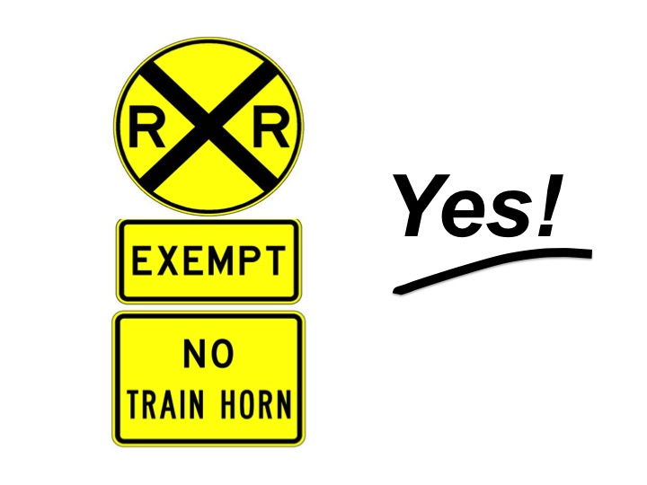
Early Communications: Gauging Interest
Notes:
We wanted to use yard signs to show support for the Quiet Zone was community-wide and not just along the tracks.
So we distributed all 80 signs that we ordered, and had requests for many more from all over the village.
We only had a limited number of signs printed up because, at that time, the committee members were footing the bill for expenses related to the Quiet Zone work.
We could have used twice as many.

Slide 12
Grass Roots to Official Group Mayor’s Special Committee Formed
2016 Special Committee for a Glendale Quiet Zone
Charged with pursuing specifics of Quiet Zone
Provide information and public input to Planning Commission and Council
Focus on requirements of a Quiet Zone, communications and financial solutions
Notes:
As the project started to gain traction, the grass roots organizing group was replaced by a formal Village committee by Mayor Lofty in October.
The group was named the “2016 Special Committee for a Glendale Quiet Zone.” Our task was to work out the specifics of implementation and provide information and public input to the Planning Commission and Council.
I serve as the chair, and the other members are Diane Agricola, Dr. Rodger Brown, Jenny Dennis, Nancy Macenko, Susan McCormick and Peg Shardelow. Carol Beaird joined the group recently to serve as recording secretary.
We have focused on the project management requirements of a Quiet Zone, especially the physical improvements at the crossings. Also communications with residents, council and the planning commission, and fundraising.

Slide 13
The Quiet Zone Committee Process since October 2016
Type of meeting | Number | Open to public
QZ Committee Meetings | 6 | ✔
Reports to Council | 6 | ✔
Reports to Planning Commission | 5 | ✔
Public Hearings | 2 | ✔
 | 19 | ✔
Notes:
Since our official founding last October, the Quiet Zone Committee has held 6 committee meetings and presented 13 updates on our work to council and the planning commission. This includes tonight’s meeting and the public meeting sponsored by the Planning Commission this past March.
In all cases, the proceedings of these public meetings are a matter of public record and minutes are available on the village website.

Slide 14
The Quiet Zone Committee Communications since October 2016
Mailed to every home | Number
Community Updates | 3
Resident’s survey | 1
Fundraising update | 1
Email and social media
Village eblasts | 24
Facebook updates on progress | Average post reaches 350
Personal email responses | 12
Notes:
In addition to those 19 public presentations, we also increased communications to neighbors.
We relied heavily on village eblasts to report our progress. We also sent two community updates, a survey, and a fundraising update to every home.
At the same time, we created a Facebook page that now, routinely reaches 350. And we responded to 12 emails asking for updates and clarification – information that we also shared in community updates or on Facebook.
Our goal was to involve the community, even at the risk of over- communicating.

Slide 15
Quiet Zone Committee Progress Village Wide Survey, February 2017
Surveys sent to 1100 households
Received a total of 516 returns
Surveys opened and tallied at public meeting
Notes:
In February, we created a survey for residents. It had a dozen questions, that attempted to gauge how homeowners felt about the Quiet Zone.
Typically, a survey is considered valid with at least 10% participation. We had far more responses than that.
We opened the surveys and tallied them at the public committee meeting in February.
Here is what we learned.

Slide 16
A Quiet Zone will positively affect quality of life and the benefit will be appreciated for generations
Quiet Zone Committee Progress Village Wide Survey Results
Notes:
Of those responding, more than two thirds supported a Quiet Zone.
98% said they hear the horns
46% said the horns negatively affect life in Glendale
70% said horns affect property values negatively
67% supported closing Albion and moving the pedestrian crossing
And 59% supported the village funding the Quiet Zone up to $150,000.

Slide 17
Quiet Zone Committee Progress Planning Commission, April 2017
Approved the Quiet Zone proposal including:
Albion landscaping, pavement removal concept
Design of new pedestrian walkway, landscaping and paving concepts
Installation of ornamental fencing along municipal parking lot
Notes:
After a public hearing on the improvements required for a Quiet Zone, including concepts for landscaping at the Albion crossing, a design of the new walkway, and the ornamental fence at the municipal parking lot,
the Glendale Planning and Historic Preservation Commission voted unanimously to formally approve the Resolution of Recommendation to Village Council.
And our work had cleared the first legislative step.

Slide 18
Quiet Zone Committee Progress Village Council, April 2017
Received the Quiet Zone proposal, asked for clarity:
Effect of closing Albion on traffic flows, fire safety
Notes:
When Council received the Quiet Zone proposal, it voted to consider it as a committee of the whole, rather than by several different committees.
In its first look at the proposal, Council asked for clarity on five issues.
The first was the effect closing Albion would have on traffic flows.
In deference to a concern raised about the water main under Albion, Council also wanted to know if closing the crossing could in any way impact fire safety.

Slide 19
Village Council Question #1 Albion Closing
Effect on traffic flow:
No significant increase in wait times
Effect on fire safety:
No impact on Village ability to fight fires
Notes:
To the first point, Council authorized an independent test closing of Albion.
Engineers conducted that study over a three week period in May. Cameras captured traffic at three intersections at various points of the day and week.
The top line results indicated no significant increase in wait times with the crossing closed.
Mark Nolt from The Kleingers Group, which conducted the test, will present further information in a couple of minutes.
As for the effect closing the Albion and fire safety, Fire Chief Kevin Hardwick confirmed it would have no impact on the Village’s ability to fight fires.

Slide 20
Quiet Zone Committee Progress Village Council, April 2017
Received the Quiet Zone proposal, asked for clarity:
Effect of closing Albion on traffic flows, fire safety
Safety of ornamental fence, entrapment potential
Notes:
The second point raised by Council was whether an ornamental fence placed alongside the municipal parking lot could have the potential to entrap pedestrians near the tracks.

Slide 21
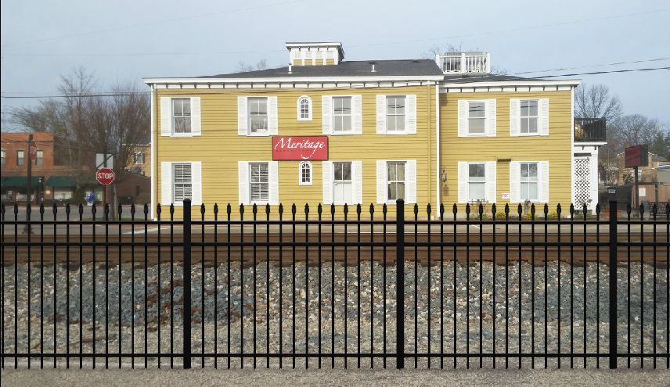
Village Council Question #2 Possible Entrapment
Potential to be trapped:
Highly unlikely
Notes:
The proposed ornamental fence will be installed at least 15 feet from the east track.
The fence running parallel behind the depot is installed nearly 20 feet away from the west track.
Village officials tested the placement of the two fences and concluded there is no reasonable cause for anyone to be entrapped during passing trains.

Slide 22
Quiet Zone Committee Progress Village Council, April 2017
Received the Quiet Zone proposal, asked for clarity:
Effect of closing Albion on traffic flows, fire safety
Safety of ornamental fence, entrapment potential
Business community support for Quiet Zone
Notes:
A third point raised by Council concerned the business support for the Quiet Zone.

Slide 23
Village Council Question #3
Business community support
Statements in Hair*
Local Yokel
Cock & Bull Public House*
Meritage Restaurant*
Village Wines of Glendale*
Stitches
Ronckers Running Spot
The Glendalia*
The Village Gift Shop
Jody Skowronek Art*
Bluebird Cafe
Notes:
Last October, owners of 11 businesses on or near the village square were asked if they support a Quiet Zone. All said they did.
The six that have asterisks next to their names, agreed to display a yard sign as well.
Subsequently, Council directed the Vice Mayor to survey all members of the Glendale Chamber of Commerce about their support of the Quiet Zone. We have not yet been made aware of those results.

Slide 24
Quiet Zone Committee Progress Village Council, April 2017
Received the Quiet Zone proposal, asked for clarity:
Effect of closing Albion on traffic flows, fire safety
Safety of ornamental fence, entrapment potential
Business community support for Quiet Zone
Federal Railroad Administration process
Notes:
The fourth question raised by Council requested information on the process used by the Federal Railroad Administration to designate a Quiet Zone.
Here are the steps…

Slide 25
Village Council Question #4 Federal Railway Authority Process
Glendale files Notice of Intent, completes risk calculation
CSX submits grade-crossing inventory to FRA
Improvements are made including Albion crossing and pedestrian walkway
Notice of Establishment is filed with the FRA
“No Train Horn” warning signs posted but covered
FRA approves the Quiet Zone
Railroads given 28 days to implement horn restrictions
Notes:
With Council’s approval of the Quiet Zone, the Village will file a NOTICE OF INTENT. It will be sent to CSX and other railroads using tracks in Glendale, as well as to the Ohio Rail Development Commission. This NOTICE OF INTENT will also be made public.
The Railroads and ORDC then have 60 days to comment. CSX and the ORDC have stated that if we do what is required in the proposal from ORDC they will not object.
The Village will then complete a Quiet Zone Risk calculation. This compares Glendale's risk to the national average and updates the grade crossing form.
Next, CSX, which is the railroad that owns tracks, sends a grade crossing inventory to Federal Railroad Administration.
After all the improvements are completed, including closing Albion and the pedestrian walkway, the Village files a NOTICE OF ESTABLISHMENT with the FRA and sends copies to railroads and ORDC.
Warning signs are posted (but covered) stating, No “Train Horns,” ready for use when Quiet Zone begins.
Finally, the FRA approves the Quiet Zone and notifies Village and railroads.
The railroad companies are given 28 days to implement horn restrictions and then the train horns will be silenced – except in an emergency.

Slide 26
Quiet Zone Committee Progress Village Council, April 2017
Received the Quiet Zone proposal, asked for clarity:
Effect of closing Albion on traffic flows, fire safety
Safety of ornamental fence, entrapment potential
Business community support for Quiet Zone
Federal Railroad Administration process
Financing
Notes:
And the last question posed by Council had its roots in the previous attempts to bring about a Quiet Zone.
It was, essentially, how are we going to pay for it. And the answer always stopped us in previous attempts.

Slide 27
Village Council Question #5 Financial
Goal $300,000
All gifts contingent upon Council’s approval of the project
Total pledged
over 5 years:
$470,420.69
Cash received to date:
$257,020.69
Gifts received from 3 foundations
70 neighbors pledged or contributed
Notes:
The Quiet Zone Committee set a goal of $300,000. That covered the initial $265,000 we knew was required, plus a contingency.
Susan McCormick, a member of the committee, agreed to head up a fundraising group to raise the $300,000. Her team started out with a $50,000 pledge from a private foundation that was spread over 5 years. That gave us the idea of offering donors the multi-year option.
We also made it clear to everyone that all pledges and gifts would be contingent upon our receiving the Council’s approval on the project. We said if it was not approved, all funds would be returned.
Within a matter of weeks, even the most optimistic among us was stunned by the results of Susan’s group. They raised a total of $470,420.69 in pledges and cash. Of that amount, $298,904.69 will be available the first year, when all of the improvements and start up changes are made. As of June 16, we have $257,020.69 in hand.

Slide 28
About the Quiet Zone Fundraising
$470,420.69
Annual maintenance
Extensive landscaping, hardscape and irrigation
Lighted brick pathway and fence
Foundation for ornamental fencing
Signage along the track
Communications to neighbors and donors
Notes:
The tremendous success of the fundraising group raises the question: How will the extra money be used?
Well, these funds can only be used for Quiet Zone-related expenses, and Council will have the ultimate decision as to their specific use.
We know there will be annual maintenance costs for the track sensors. One possibility is to endow those expenses into the future
We can also bring in additional lighting, landscaping, hardscape and irrigation to the new pedestrian crossing – to create a welcoming entrance for visitors walking into the village square.
Another possible use is the addition of a concrete base for the ornamental fence. It would match the base on the depot fence. This would help protect the fence from damage by cars and trucks.
We can also add signage along the track, and keep contributors and neighbors informed on how the funds are being spent.

Slide 29
Quiet Zone Initiative
Next Steps
Council approves proposal
Notice of intent is filed with ORDC, CSX and other railroads
A period of 60 days is set for comment
Glendale completes improvements, applies to FRA.
Notes:
What’s next?
If Glendale Village Council approves the Quiet Zone the next step is for the village to file a NOTICE OF INTENT with ORDC, CSX and other railroads using our tracks.
The railroads and the State then have 60 days to comment.
Once the improvements are complete, we will ask the FRA for the Quiet Zone designation.

Slide 30
Notes:
Thank you for being here tonight, and for helping to bring this important program one step closer to reality.
And now I’d like to introduce Matt Dietrich, the Executive Director of the Ohio Rail Development Commission.

